Slide 1
Donations & Death
December 22, 2020
Howard Berish FCPA, FCA

Slide 2
AGENDA
Taxation on Death Basics
Donations on Death (Pre 2016)
Donations on Death (Post 2015)
Donations from Spousal Trusts
Donations in Kind (Quebec)

Slide 3
Taxation on death
General rule:
Deemed Disposition of all assets at fair market value at time of death.
Resulting capital gains (losses) and full value of RRSPs and RRIFs must be reported on the deceased’s final return.
Capital losses carryforward and arising in the year of death may be claimed against other income.

Slide 4
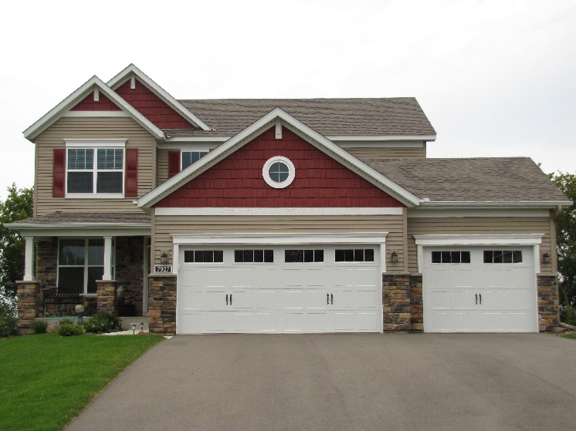
Taxation on death
Exceptions:
Principal residence.
Life insurance proceeds.
Anything left to spouse, common law partner or spousal trust.

Slide 5
Taxation on death
Planning to reduce tax on death:
Pre-death: Estate freeze & insurance.
Testamentary: Bequests to spouse/spousal trust & gifts to charity.
Post-mortem: Gifts to charity by estate.

Slide 6
Taxation on death
Rollovers between spouses:
Deemed disposition at cost so that no gain or loss is realized.
*Unless* deceased’s legal representative elects (on an asset by asset basis) to realize certain gains (e.g. where deceased has unused losses or donations).
Tax payable by spousal trust on death of surviving spouse.
Can choose to pay tax on RRSPs or RRIFs.
Notes:
Anything left to a spouse, common-law partner, or Spousal trust is deemed to have been disposed of at cost so that no gain or loss is realized.

Slide 7
Donations on death pre 2016
Donations by will could be used on the deceased’s final return or on the return for the year prior to death.
Donation limit up to 100% of net income.
Donation receipt based on FMV of the property at the date of death.

Slide 8
DONATIONS ON DEATH POST 2015
Graduated Rate Estate (GRE)
Estate arising on and as a consequence of an individual’s death;
Not a trust, but satisfies conditions in The Income Tax Act for a testamentary trust;
Not more than 36 months have passed since the date of death;
Deceased’s SIN is shown on the estate’s tax return;
Designates itself as a GRE on its first tax return; and
No other estate of the individual is designated as a GRE

Slide 9
DONATIONS ON DEATH POST 2015
Benefits of a GRE
Graduated tax rates.
No obligation to make instalments.
Certain exemptions for minimum tax and Part XII.2 tax.
May allocate investment tax credits to beneficiaries.
Take advantage of tax planning strategies to avoid double taxation.
Extended time period to file a Notice of Objection.
Greater flexibility on the use of charitable donation credits.

Slide 10
DONATIONS ON DEATH POST 2015
Flexibility for donation tax credit:
Donation credit for gifts made by GRE within 36 months of death may be claimed by:
Deceased in year of death.
Deceased in year prior to death.
Estate in year of donation.
Estate in any year prior to the year of donation.
Estate in any of the five years following the donation.
Notes:
(assumed gift made from assets owned , or substituted for assets owned at date of death):
Where donation made within five years of death, may choose to use tax credit where most advantageous – including to offset tax on capital gain arising on death.

Slide 11
DONATIONS ON DEATH POST 2015
Flexibility extended to gifts made 37-60 months following death by estate that was a GRE and continues to meet the other GRE criteria.
If gift made prior to filing of final tax return receipt donation may be claimed on final return.
If gift made after final return is filed, must pay tax without taking into consideration the gift. Any balance of tax not paid is subject to interest (however, see next slide).
When gift made after final return is filed, estate must elect to carryback donation to final and a T1ADJ should be filed.

Slide 12
DONATIONS ON DEATH POST 2015
Per CRA for gifts that will be received later you must provide
a copy of all of the following:
The will;
A letter from the estate to the charitable organization that will receive the gift, advising of the gift, a description of the property being gifted and estimated value;
A letter from the charitable organization acknowledging the gift and stating that it will accept the gift;
Cont. next page

Slide 13
DONATIONS ON DEATH POST 2015
Per CRA for gifts that will be received later you must provide
a copy of all of the following:
A statement or letter from the legal representative of the estate stating all of the following:
The estate is a GRE of the deceased individual and will be designating itself as such;
The estate intends to make the gift within 60 months after death;
The amount of the gift claimed on the final return of the deceased individual will not be claimed on any other return;
For non-cash gifts, the value of the future gift can be reasonably ascertained and supported.

Slide 14
DONATIONS ON DEATH POST 2015
Different planning where asset left to Spousal trust – donation may be used by trust to offset tax arising on death of surviving spouse (however, see following slides).
Donation of non-cash gift will equal the fair market value of the property at date of donation.
Donations made in year of death but prior to death may be used by either spouse. Donations made by the estate after death can only be used by deceased or estate.
Donation limit up to 100% of net income.

Slide 15
DONATIONS from spousal trusts
CASE STUDY – Assume the following:
Mr. A leaves all or part of his estate to a Spousal trust.
Assets left to the Spousal trust include assets with a low Adjusted Cost Base (ACB) and a high Fair Market Value (FMV).
The terms of the Spousal trust ‘REQUIRES” that on the death of the second spouse all or part of the assets of the Spousal trust must go to a named charity or charities.
The testator assumed that the tax benefits from the donation would offset all or part of the tax on the capital gain arising on the deemed disposition of the assets at the time of the second spouse’s death.
Notes:
NOTE: This problem may apply to non-spousal trusts as well, but the situations where that would arise would be rare.

Slide 16
DONATIONS from spousal trusts
CASE STUDY – Continued:
THE PROBLEM: It is the CRA’s legal interpretation that where the original testator ”REQUIRED” the spousal trust to make the donation, it is not, in law, a donation. The charity would be considered a beneficiary.
The Spousal trust did not have a charitable intent, the gift was not made gratuitously, and therefore as per CRA it is not a donation.
No tax benefit will be realized from the amount left to charity and the Spousal trust will have to pay tax on the capital gains from the deemed disposition.

Slide 17
DONATIONS from spousal trusts
CASE STUDY – Continued:
THE SOLUTION: The terms of the Spousal trust should provide the trustees with the “RIGHT”, but not the obligation, to make the donation at their discretion.
The original testator may leave a “Letter of Wishes” or a similar document to the trustees specifying his/her charitable wishes, but this is not binding on the trustees.
Notes:
Describe letter of wishes – and how JCF can help with this

Slide 18
DONATIONS from spousal trusts
Sample Wording for Bequest:
My EXECUTORS, at their absolute discretion shall have the right to make donations to a Canadian registered charity or charities to a maximum amount of assets having a value of ($xxx,xxx.xx) or such lesser amount.
Notes:
Describe letter of wishes – and how JCF can help with this

Slide 19
DONATIONS in kind - quebec
Prior to 2016 it was generally accepted that the tax benefits from making a donation could be claimed by either spouse, regardless of the actual donor (administrative policy).
Effective 2016, Federally this administrative policy was made law so taxpayers no longer have to rely on administrative discretion. MRQ did not harmonize with the Federal change.
MRQ’s administrative policy does not apply to Gifts In Kind. Gifts In Kind can only be claimed by the actual donor.
With the proliferation of gifts In Kind, particularly marketable securities, including flow through mining shares, professionals and their clients should keep this “Made In Quebec” policy in mind.

Slide 20
Questions?
Thank You!

