Slide 1
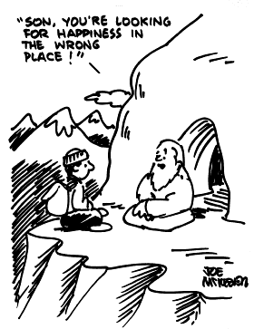
The Science of Happiness
www.talbenshahar.com

Slide 2
PERMISSION TO BE HUMAN
The paradox
“Those who don’t know how to weep with their whole heart don’t know how to laugh either.” Golda Meir
Not about resignation
Active acceptance
Notes:
At work, 2 examples: Men and women.
2 levels of suffering.
3 ways of expressing—cry, talk, write…

Slide 3
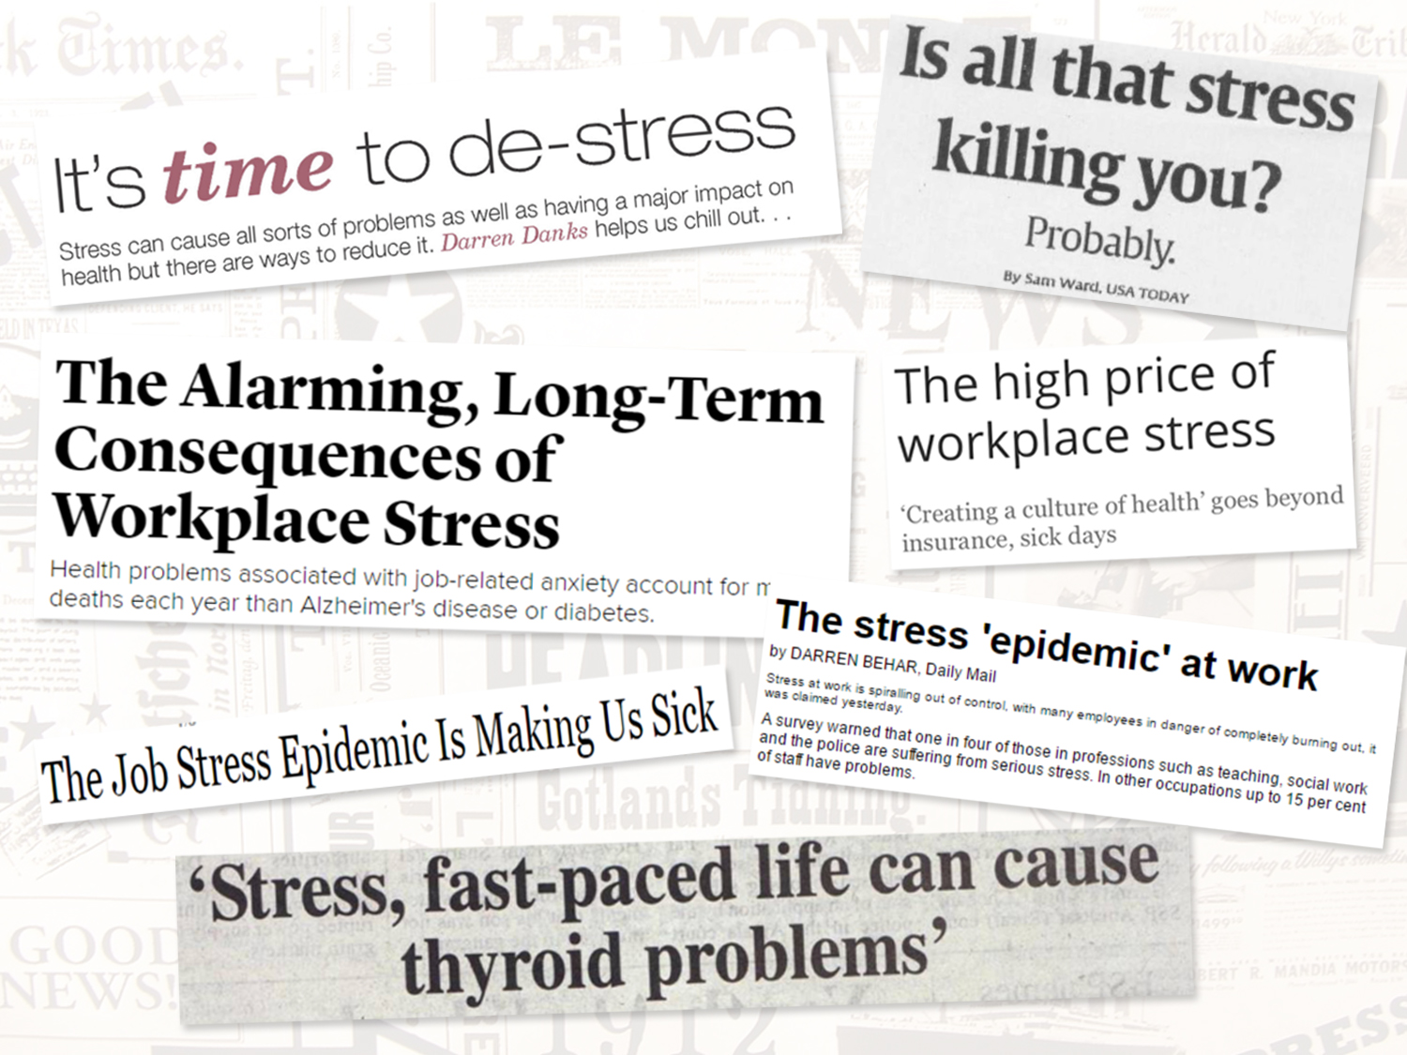
STRESS PANDEMIC
Notes:
Today, more extreme than this… Colleges, 94%... Around world… Even Australia… Why? Juggle too much on our hands. Hope by end of day, calmer, like this:

Slide 4
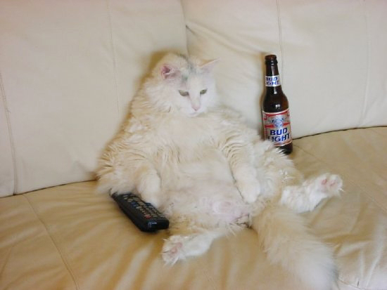
Notes:
This is about stress and energy
Stress massive problem across the world
China – concerns re stress in the workplace
Any Australians in room? Even there stressed
By time getting to end of programme feel like this >

Slide 5
Stress is not the problem…
… Lack of recovery is the problem
Energise with multi-level recovery
MICRO (minutes, hours)
MEZZO (nights, days)
MACRO (weeks, months)
Notes:
Lack of recovery that is the problem.
Last week, discussed anti fragile—gym work makes you stronger—potentially! If recovery, can increase likelihood of PTG, stronger.

Slide 6
GIVING
On the benefits of charity
On the benefits of kindness
“You can always, always give something, even if it is only kindness.” Anne Frank
On the benefits of listening
נ ת נ
NATAN

Slide 7
Takers
Matchers
Givers

Slide 8
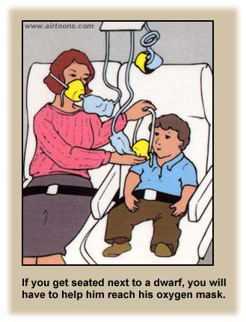
Performance
Top
Middle
Bottom
Givers
Takers
Matchers
Givers

Slide 9
“Caring for others based only on your sacrifice doesn’t last. Caring must also feed you.” Dalai Lama
"If I am not for myself, who will be for me? But if I am only for myself, who am I? If not now, when?”
Rabbi Hillel

