Slide 1
Ethics and Stewardship in Fundraising
Presented by Paulanne Jushkevich, MA, CFRE
President,
Connecticut Children’s Foundation
October 12, 2023

Slide 2
Ethics and Stewardship

Slide 3
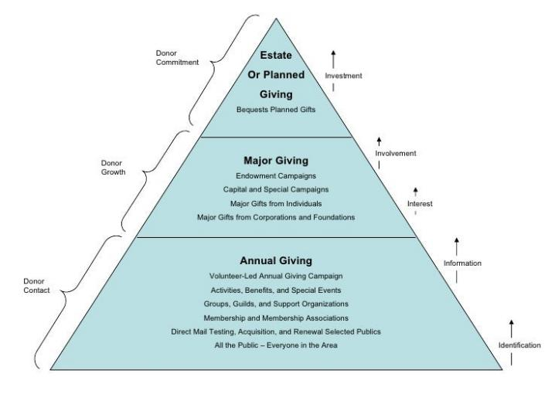
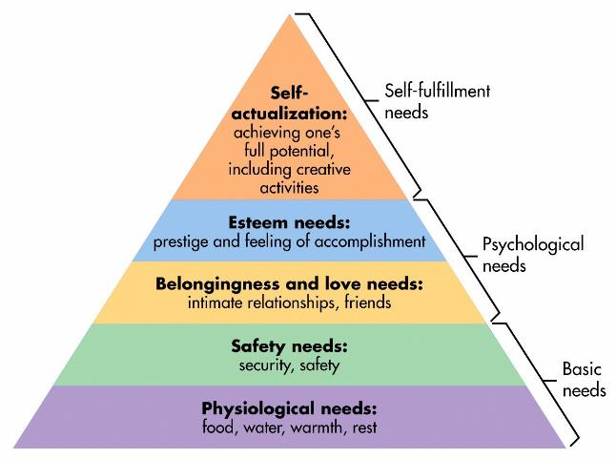
Ethics and Stewardship

Slide 4
Ethics and Stewardship

Slide 5
Ethics and Stewardship

Slide 6
Ethics and Stewardship

Slide 7
Ethics and Stewardship
What is Ethics NOT?
. . . For the faint of heart

Slide 8
Ethics and Stewardship

Slide 9
Ethics and Stewardship

Slide 10
Ethics and Stewardship
Why Ethics?
It is not good enough the Canadian charities just follow the law but there are important ethical considerations as well as standards that Canadian nonprofits and charities need to be aware of.

Slide 11
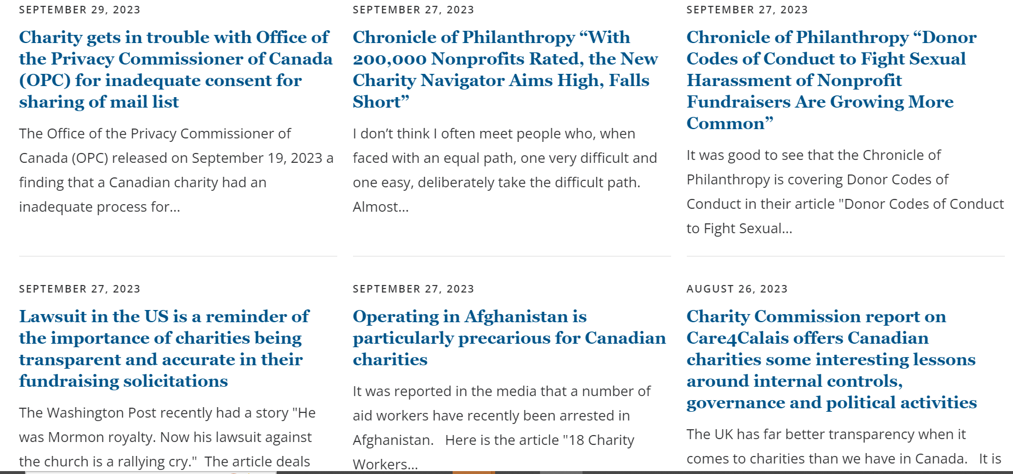
Ethics and Stewardship

Slide 12
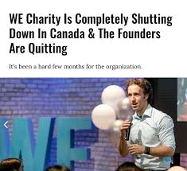
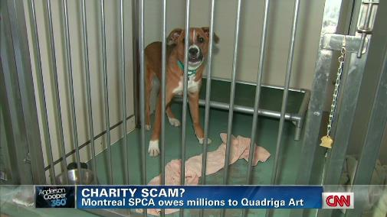
Ethics and Stewardship

Slide 13
Ethics and Stewardship

Slide 14
Ethics and Stewardship

Slide 15
Ethics and Stewardship

Slide 16
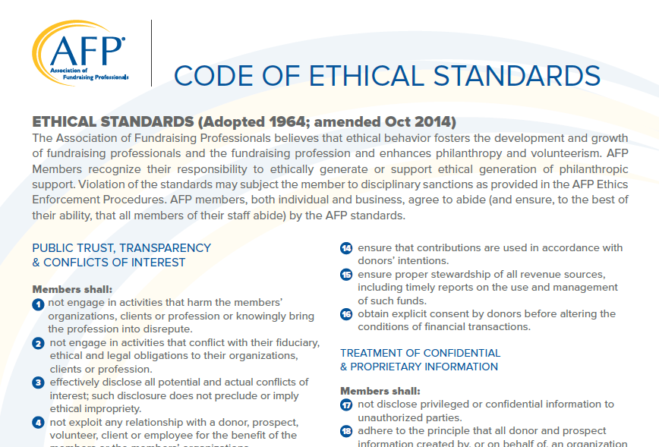
Ethics and Stewardship
Ethical governance of a donor’s gift does not only begin when the gift exchanges hands . . .

Slide 17
Ethics and Stewardship

Slide 18
Ethics and Stewardship

Slide 19
Ethics and Stewardship

Slide 20
Ethics and Stewardship

Slide 21
Ethics and Stewardship

Slide 22
Ethics and Stewardship

Slide 23
Ethics and Stewardship
Challenges That Can Cause Ethical Dilemmas:
Extreme goal pressures that are not data-based
Lack of experience
Dilemmas without clear solutions
Superiors who don’t understand fundraising/ethical standards associated with our profession
Impulsive decision-making
Donors who want to control their gift
Ignorance of the Donor Bill of Rights or the AFP Ethical Fundraising Guide

Slide 24
Stewardship

Slide 25
Ethics and Stewardship

Slide 26
Ethics and Stewardship

Slide 27
Ethics and Stewardship
Acknowledgment
Expression of Gratitude
Demonstration of Accountability

Slide 28
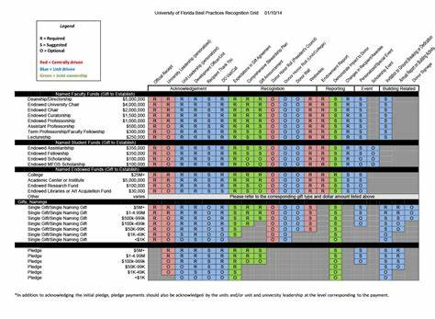
Ethics and Stewardship

Slide 29
Ethics and Stewardship

Slide 30
Ethics and Stewardship

Slide 31
Ethics and Stewardship
it costs nonprofits about 10 times more to bring in a new donor than to keep an existing donor.
2018 Fundraising Effectiveness Report : For each 100 new donors nonprofits brought in, they lost 99.

Slide 32
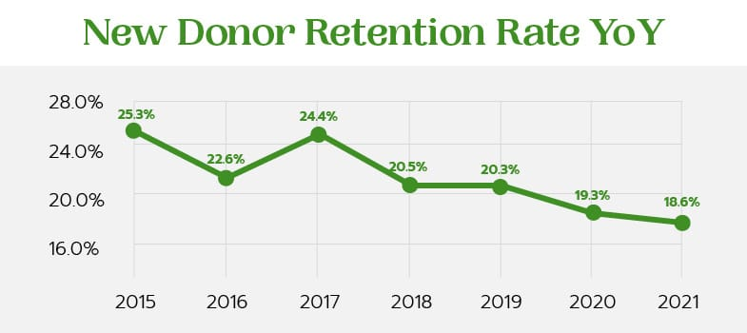
Ethics and Stewardship

Slide 33
Ethics and Stewardship

Slide 34
Ethics and Stewardship

Slide 35
Ethics and Stewardship

Slide 36
Ethics and Stewardship

Slide 37
Ethics and Stewardship

Slide 38
Thank you
Paulanne Jushkevich, MA, CFRE
President,
Connecticut Children’s Foundation

